Slide 1
Bike showroom System
Milan Parmar - 240160510031

Slide 2
Existing SystemCurrently, many bike showrooms manage operations using manual records or basic software tools like Excel or offline databases. These methods often lack integration and real-time tracking. Tasks such as inventory updates, sales recording, customer tracking, and service management are performed separately, which can lead to data inconsistency and inefficiencies
Existing System ProblemsShowrooms using manual or semi-digital systems face challenges like inventory mismatches, missed service appointments, and sales tracking issues.Lack of real-time updates causes delays in decision-making.
Customer service is often affected due to limited access to historical data or service records.There's no centralized system to manage bike models, customer interactions, servicing, and staff responsibilities efficiently.

Slide 3
New SystemThis system allows bike showroom staff to manage bikes,
customers, sales, and service records through a centralized digital platform.It provides real-time updates on inventory, customer interactions, and service requests.The system improves efficiency by automating tasks like billing, bike registration, and scheduling service appointments, helping streamline overall operations.
Need for a New SystemExisting manual or semi-automated systems do not provide real-time data or centralized control, leading to operational inefficiencies.There is a growing need for a digital solution that can manage bike inventory, monitor staff roles, handle customer data, and generate performance reports.Automating the system ensures faster processing, reduces human error, and enhances customer satisfaction.

Slide 4
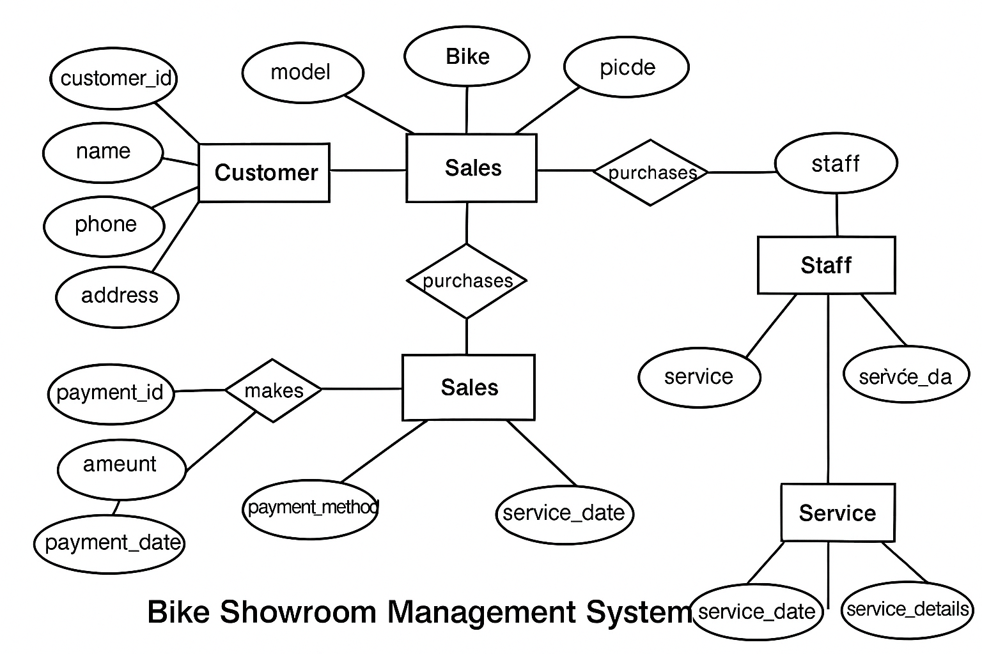

Slide 5
Admin:
:- The page require user name and password to start the application.
:- Login is a process by which individual access to a computer system is controlled by identifying and
authenticating the user through the cardinalities presented by the user.
:- Admin can add, update or delete the user.
:- Admin can add, update or delete the products.
:- Admin can add, update or delete the gallery.
:- Only Admin can change his/her password.
:- Admin can view the feedback of user.

Slide 6
Customer:
:- Customer can register the account by fill the information about you and click on save button.
:- He/she can add the account for the further enquiry of the Product buying.
The customer have to login to get more information about the Product and Showroom.
:- The customer can buy the Product, view the Product and also give the feedback about Product and Showroom.

Slide 7
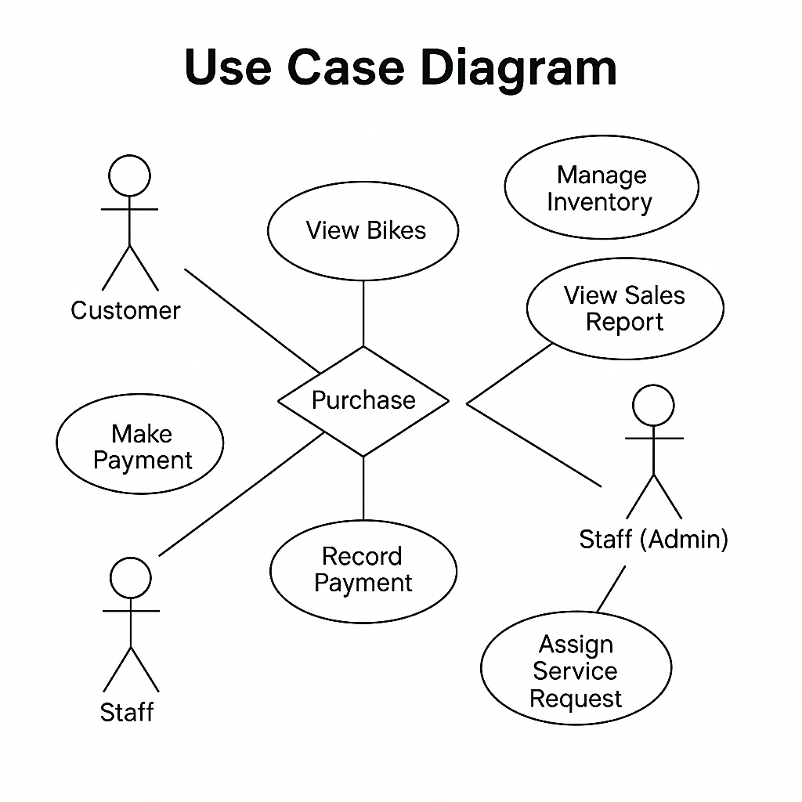

Slide 8
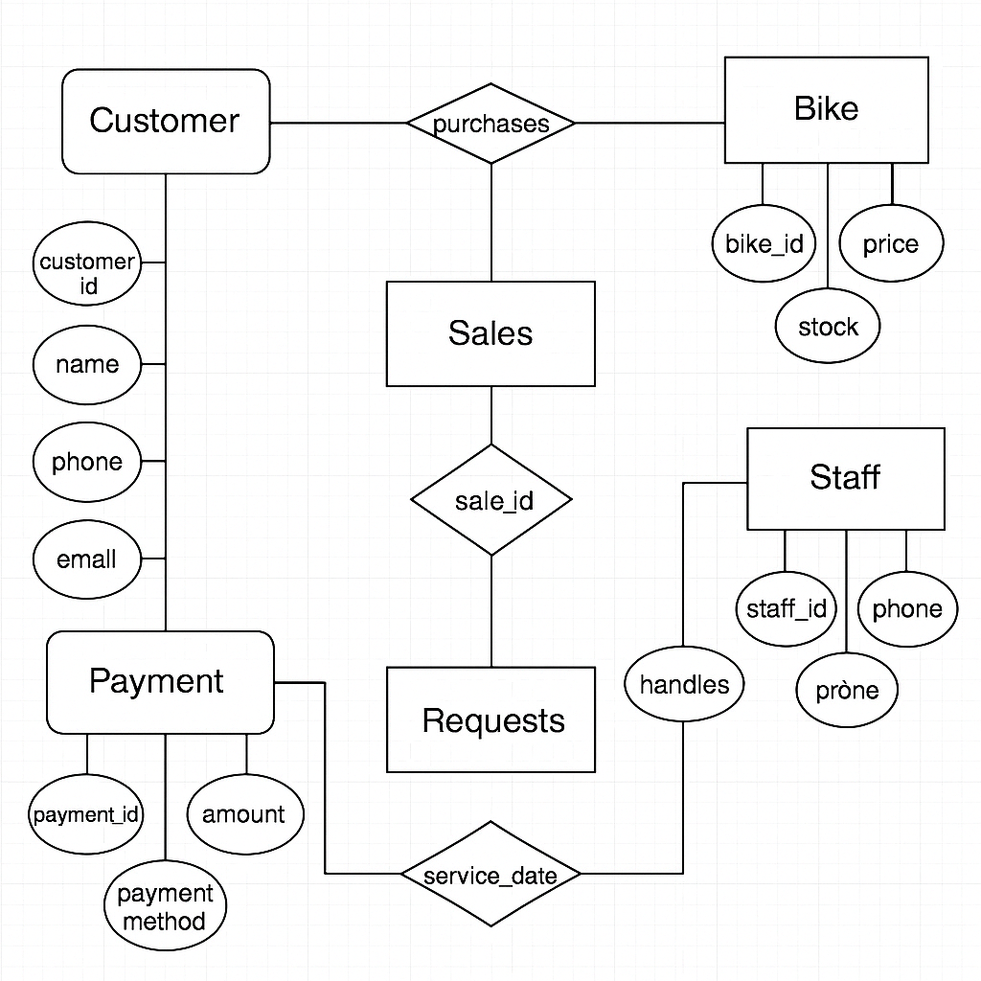

Slide 9
admin_login_table
Description: Contains information related to admin login credentials and access.
Fields:
admin_id (Primary Key)
username
password
last_login_time

Slide 10
2. supplier_product_table
Description: Stores detailed product (bike) information supplied to the showroom
.Fields
:product_id (Primary Key)
model_name
Brand
engine_capacity
Price
stock_quantity
supplier_name

Slide 11
3. customer_table
Description: Stores personal and account details of customers.
Fields:
customer_id (Primary Key)
name
email
phone
address
username
password

Slide 12
4. order_table
Description: Maintains details about customer orders.
Fields:
order_id (Primary Key)
customer_id (Foreign Key)
product_id (Foreign Key)
order_date
delivery_date
order_status
payment_status

Slide 13
Thank you…

